Slide 1
Closed Pair Problem

Slide 2
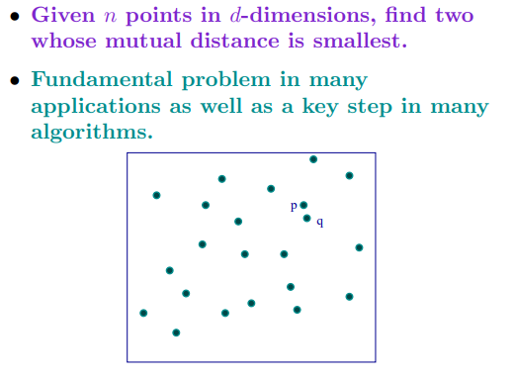
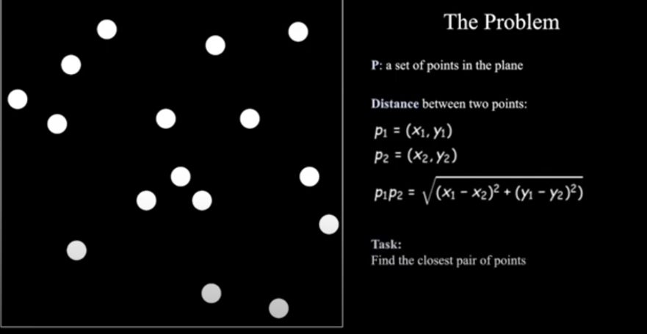
Closest Pair Problem
We are given an array of n points in the plane, and the problem is to find out the closest pair of points in the array.

Slide 3
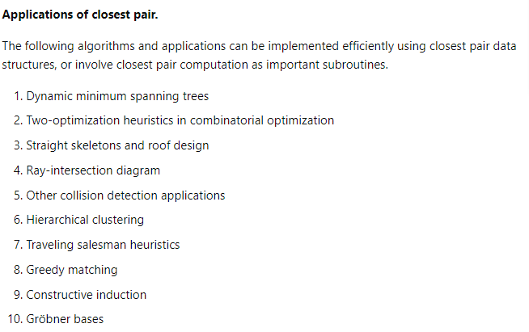
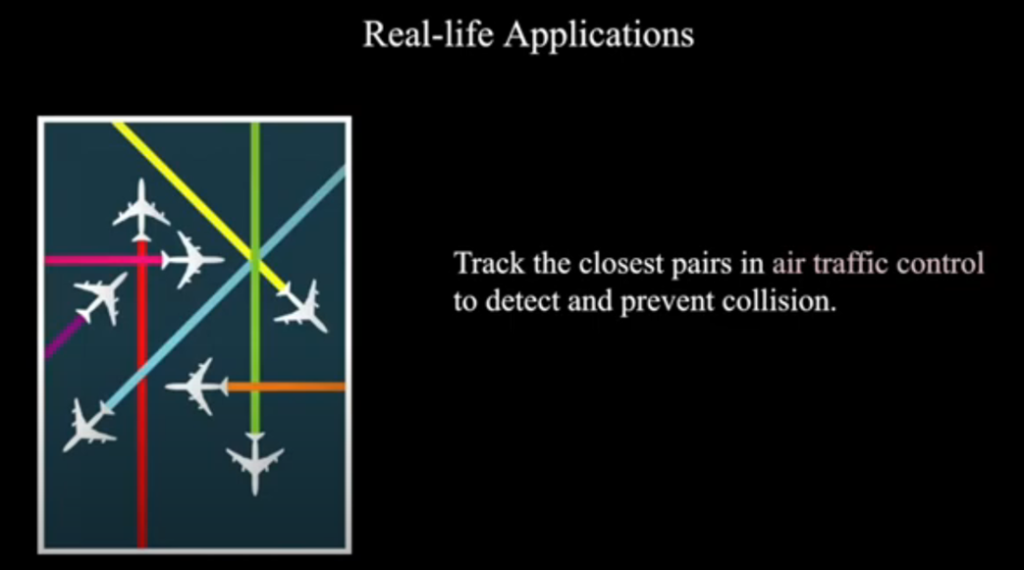
Real time applications of Closest Pair Problem

Slide 4
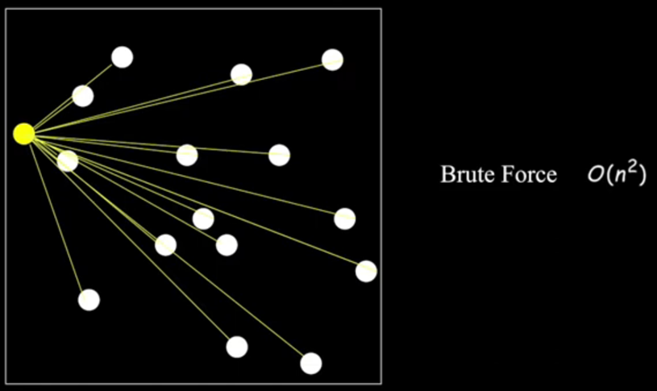
Brute Force approach

Slide 5
Divide and Conquer Technique

Slide 6
Divide and Conquer Technique for closest pair problem
We sort all points according to x coordinates.
Divide all points in two halves.
Recursively find the smallest distances in both subarrays.
Take the minimum of two smallest distances. Let the minimum be d.
Create an array strip[] that stores all points which are at most d distance away from the middle line dividing the two sets.
Find the smallest distance in strip[].
Return the minimum of d and the smallest distance calculated in above step 6.

Slide 7
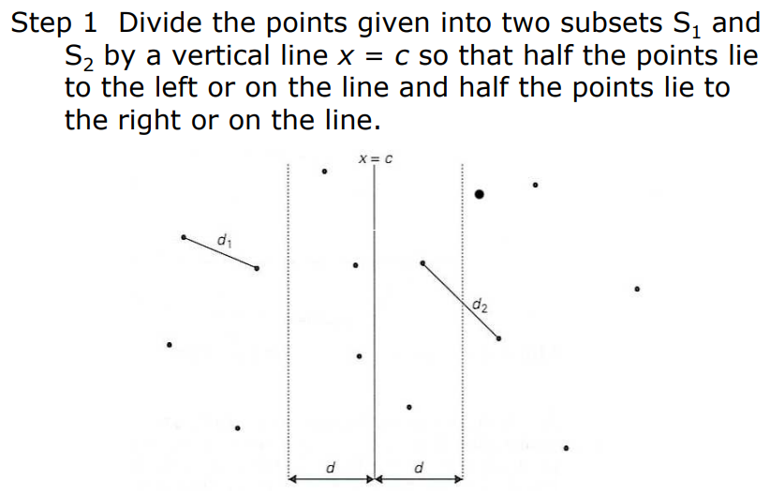
Divide and Conquer Technique for closest pair problem

Slide 8
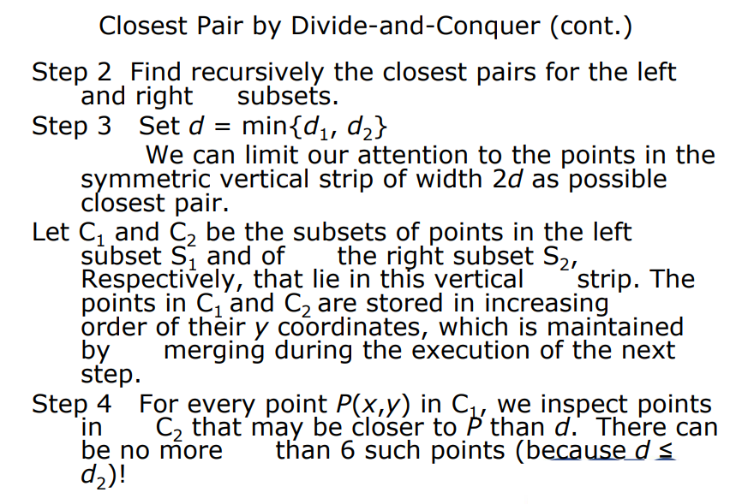

Slide 9
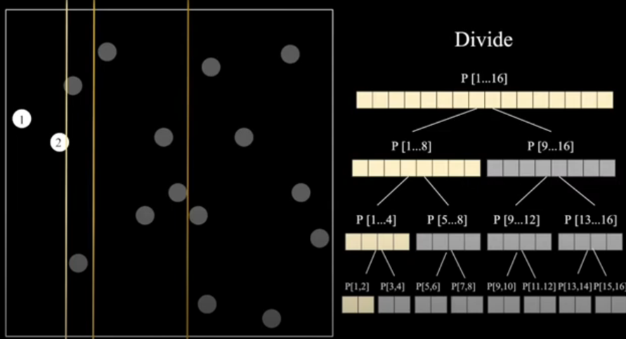
Divide the points

Slide 10
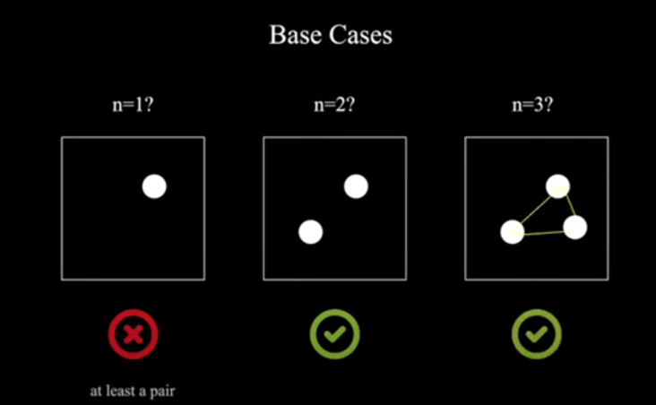
Base case for Divide and conquer technique

Slide 11
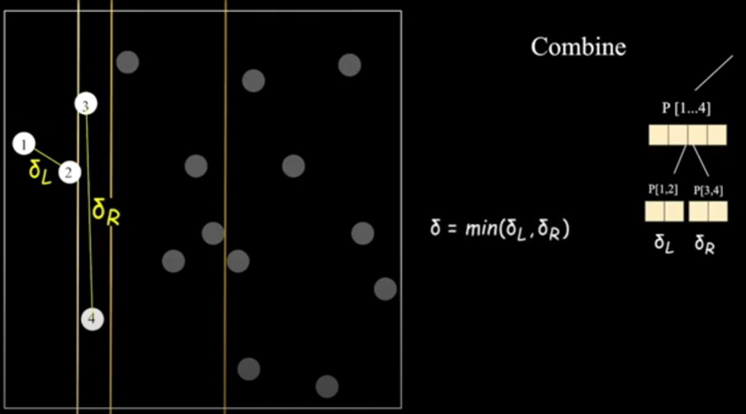
Combine the minimum distance

Slide 12
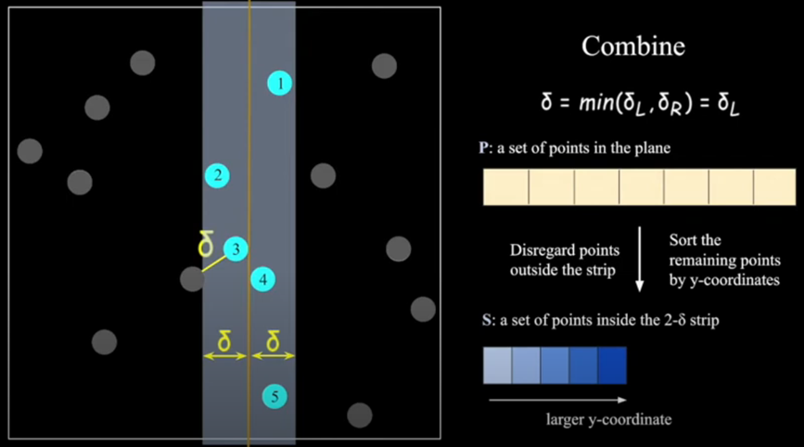
Optimal way to find the closest point in the strip

Slide 13
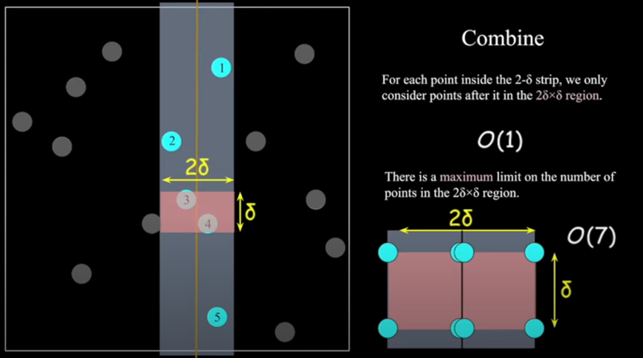
Optimal way to find the closest point in the strip

Slide 14
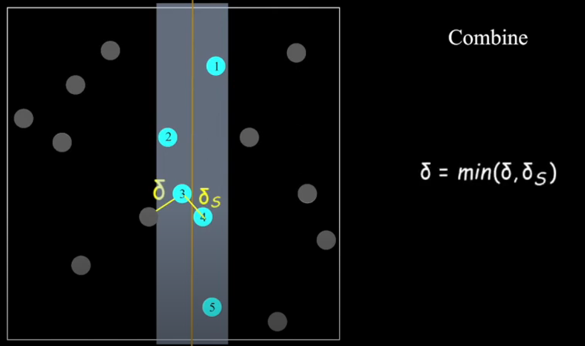
Combine procedure

Slide 15
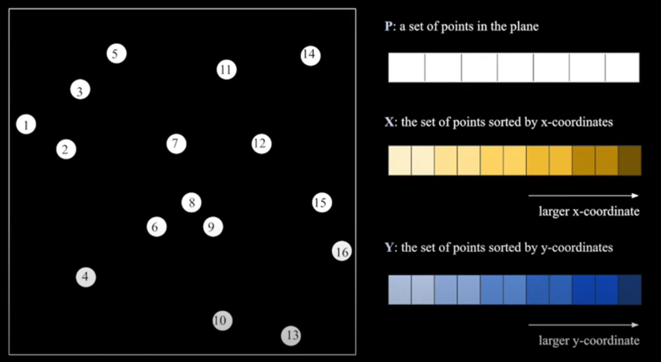
Combine procedure

Slide 16
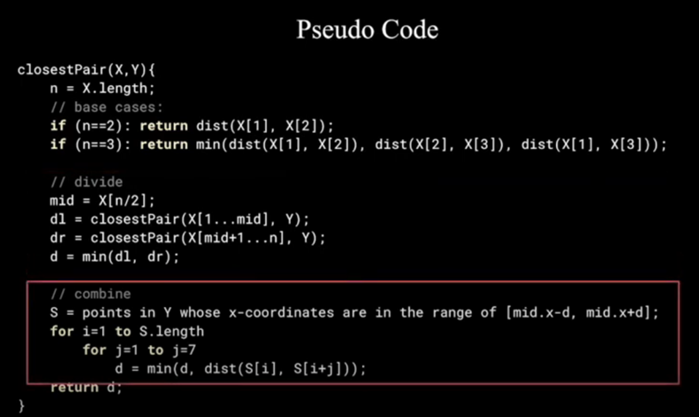
Closest pair problem - Divide and conquer strategy

Slide 17
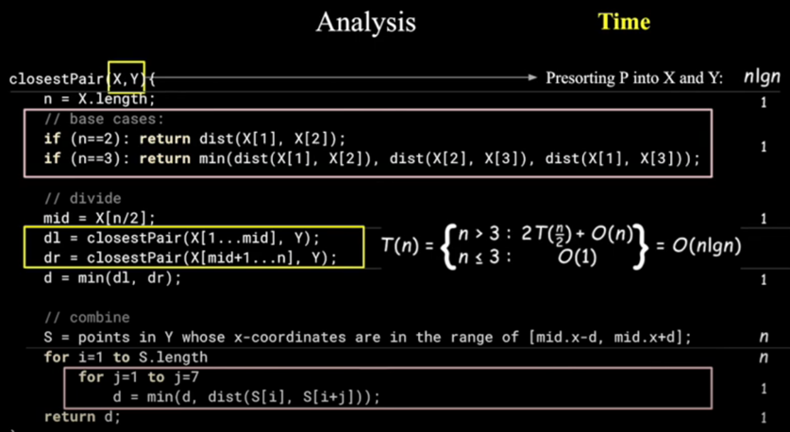
Time complexity analysis

Slide 18
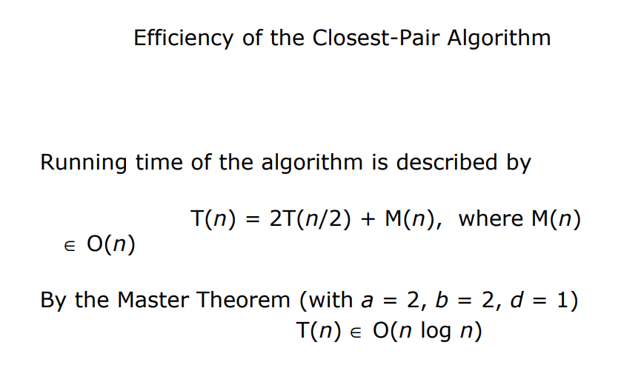
Time complexity of closest pair algorithm

